Slide 1
A short introduction to microarrays and expression analysis

Slide 2
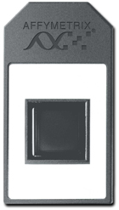
Expression by microarrays How does it work?

Slide 3
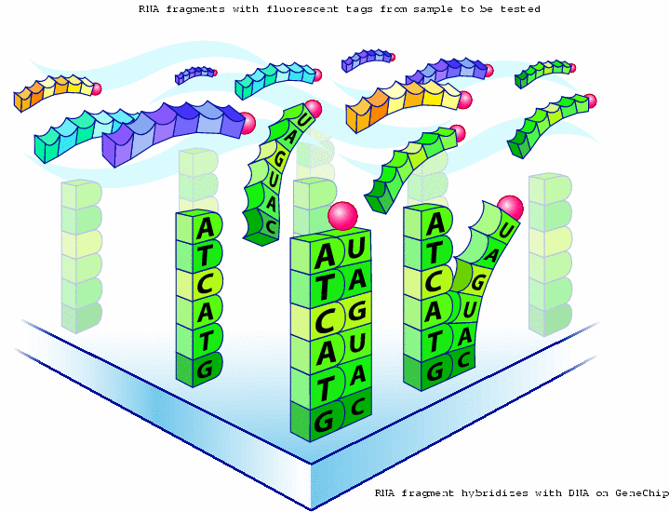
Fundamentally based on hybridization and color signals
We design pieces of DNA that are complementary to that of “all” known genes
We attach these to a glass slide
We then make single stranded cDNAs from RNAs, and add a color molecule to each cDNA
The probes which hybridize to the cDNAs will “glow” – and then we can measure expression of all genes at once

Slide 4
A simplified movie
https://www.youtube.com/watch?v=0ATUjAxNf6U

Slide 5
Some applications
Compare the mRNA levels between different conditions.
Do discovery projects instead of looking at your favorite gene
Finding differentially expressed genes, for instance genes that are higher expressed in some cancer tissue compared to normal tissue
Target selection (disease related proteins)
Classification of disease (for optimal treatment)
Genetic warning signs (adjust lifestyle)
Notes:
Move target selection

Slide 6
The “problem” with microarrays
Arguably the most mature high-throughput technology (RNA-seq is catching up)
A lot of theory and possible analyses
A lot of (quite complex) R packages – most of the Bioconductor package is about these things
If you want to become a professional in array analysis, bioconductor is the thing to go after

Slide 7
We could have an entire course about this
But instead I have chosen to only have one lecture
Goals
Understanding the technique
Understanding typical problems and typical things done with array data
A few general analyses that can also be applied with later data in the course
Highlight a few R analyses for future reading

Slide 8
There are many types of arrays…
Probes on surface
Glass beads, chips, slides
Arrays can detect
mRNA
microRNA
Methylation
SNP
And many brands who do things slightly differently – one has to be aware of what brand that is used for subsequent analys. Arguably Affymetrix chips are the standard.

Slide 9
Example of affymetrix chip
Probes are synthesized on a chip
- Probes are oligonculeotides of a specified length, Generally 25 mers
Several probe pairs (PM and MM) selected from the target sequence
10000 - 50000 probe sets per chip, with several probe sets per gene

Slide 10
How do we design the best probes?
Say that we want to make probes for all the refseq genes in the genome browser. We can only have one probe per gene, of 30 nt
What features are we looking for?
How should we select probes?
What are the possible disadvantages with your approach?
3 minutes with your neighbor.

Slide 11
Probe design is always a trade off
Maybe the whole gene have a very low gc-content
Or the regions having the same gc-content as the rest of the probes where not unique
Not possible to design perfect probes for all genes
For this reason it is normal to use more probes pr gene randomly distributed on the chip.

Slide 12
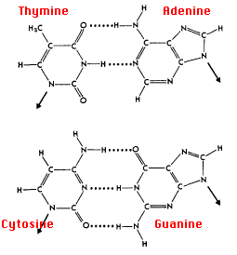
Important issue
Different probes have different affinities ->Measurements are relative, not quantitative.
A-T/U
(2 H-bonds)
G-C
(3 H-bonds)

Slide 13
This means…
That we cannot directly compare between different probes – this is meaningless
However, we can compare the same probe between two experiments
Challenge:
I have made two array experiments with the same set of probes – before and after treatment
Now, for my gene of interest, the signal is doubled after treatment. Can we then say that the gene is twice as highly expressed? If not, why?

Slide 14
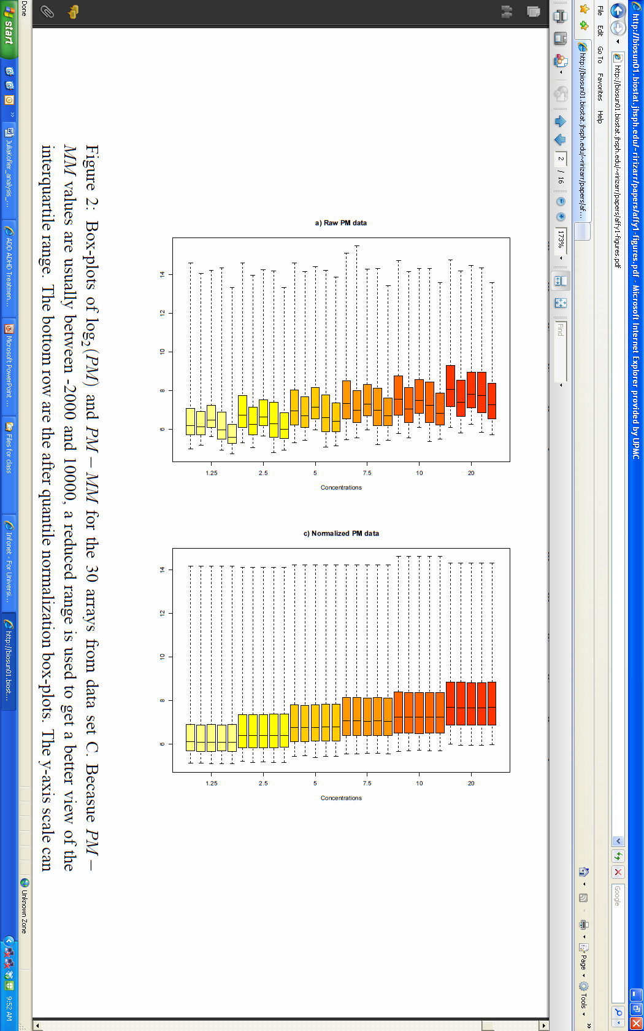
Normalization
The goal is to transform the data so that they follow the same distributions. Individual genes might be different between samples, but the overall distribution should be the same.
This will then, ideally, correct for things like washing efficiency, etc
Many different ways of doing it – and there are R packages for most.
Quantile normalization is common (will not go into details here)

Slide 15
Normalization part 2
Assumptions for making these types of normalizations:
The majority of genes are not regulated (changing in expression)
For a given intensity range there is a roughly equal amount of up- and down regulated genes
Breaks down when:
Microarray is targeting few genes
When many genes are regulated and/or changing in the same direction

Slide 16
Small example of quantile normalizing of 4 genes across 3 samples using the bioconductor package
library(preprocessCore) # see notes below slide on how to install
mat <- matrix(c(5,2,3,4,4,1,4,2,3,4,6,8), ncol=3) # made up data
> mat
[,1] [,2] [,3]
[1,] 5 4 3
[2,] 2 1 4
[3,] 3 4 6
[4,] 4 2 8
>boxplot(mat)
Notes:
How to install the quantile functoinfrom Bioconductor.
source('http://bioconductor.org/biocLite.R’)
biocLite('preprocessCore')
This will prompt you to install a lot of stuff which it is dependent on though.

Slide 17
> mat
[,1] [,2] [,3]
[1,] 5 4 3
[2,] 2 1 4
[3,] 3 4 6
[4,] 4 2 8
>boxplot(mat)
mat2<-normalize.quantiles(mat)
> mat2
[,1] [,2] [,3]
[1,] 5.666667 5.166667 2.000000
[2,] 2.000000 2.000000 3.000000
[3,] 3.000000 5.166667 4.666667
[4,] 4.666667 3.000000 5.666667
boxplot(mat2)
This operation makes little sense to do with so few genes as this – they will invariably be squashed to the same distribution. Only makes sense if the number of genes is large and most do not change between treatments

Slide 18
The MA-plot – a way to visualize changes and strength at the same time – also used to assess normalizations
Originally made for microarrays, to look at the red/green ratio of probes. For a given probe, we calculate two values:
M=log (red color intensity/green color intensity)
Will correspond to the difference between samples. Often called the fold change
A= 0.5* log( red color intensity + green color intensity)
Is the average between both colors – will represent the overall signal
With more signal in A , we tend to believe small changes in M. Or, the other way around, high fold changes are only believable with decent A values

Slide 19
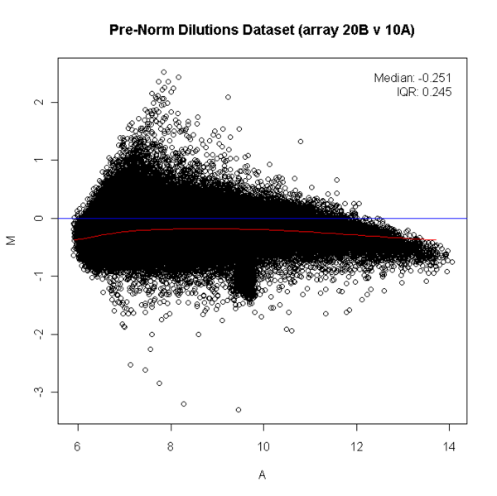
Blue: the 0 line. We would expect the mean over probes to be here
Red: the actual mean
across probes

Slide 20
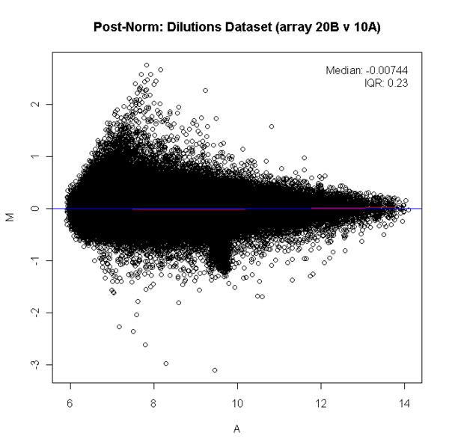
After normalization the mean is on the zero line
We will see the MA plot later on also for other platforms, like sequencing

Slide 21
Important:
While the MA plot was ‘invented’ for microarrays, it is equally useful for all high-throughput gene expression data. The concept is exactly the same

Slide 22
How does microarray data look like, after normalization?
sample1 sample2 sample3 sample 4 etc
Gene1 8.12973105882718 8.15671851682818 7.97550860176238 8.45243298480556 8.16975702795475 8.28091856216011 8.09776685836106 8.34920243804677 8.32691899859751 8.10243290798462
Gene2 6.82465356937095 6.86052096281367 6.89035665630681 6.61727069057472 6.85243743408438 6.48785004146141 6.91371355832305 6.65375450525229 6.59660322980148 6.81101073980938
Gene3 6.81644879372158 6.8183470453091 6.86053392715829 6.87348874336384 6.57298946173209 6.97683366192805 6.78151600978573 7.00314998315011 6.73874813979547 6.70020717044792
Gene4 9.1926622542419 9.6127070318993 9.50204965108923 10.0293466902138 9.30969143699883 9.50691284771676 9.54177679225632 9.89129178421213 9.79559118300174 9.28856821870519
Gene5 5.03915917632092 5.02004039184415 4.98254613161106 5.05812523857075 4.97958428739462 5.06408527263732 4.98646831277986 4.99443774838158 5.10596989334831 5.10079391297934
Gene6 9.44501085028328 9.08913155339512 9.13049433407458 8.69549645052268 9.50812591121419
Etc
Etc
This file is only meaningful if I know what the samples are.
In this case it is a study of 5 HIV patients and 5 controls (one column each)
This is what we call an expression matrix. Again, if we use other expression methods,
we typically also end up in matrices that look very similar.

Slide 23
Statistical testing
…is pretty much done like we have talked about – for every genes, we have probe intensities for treatment and control (hopefully many replicates), and then we test these vs. one another.
For microarray data, it is common to use the limma package to do differential expression. This is an advanced form of a linear model.
We often filter out genes that have a low fold change value to start with to reduce the number of tests (why?)

Slide 24
HIV1 HIV2 HIV3 HIV4 HIV5 CNTRL1 CNTRL2 CNTRL3 CNTRL4 CNTRL5
Gene1
Gene2
Gene3
etc
P-value
P-value
P-value

Slide 25
We can also use the MA plot to visualize significance
If we make a statistical test and label some genes as changing in a significant way, we can also label these in the MA plot
Remember to adjust for multiple testing!

Slide 26
An MA plot where genes that are significantly changing (FDR<0.05) are colored red. This then shows both whether normalization works and what patterns significant genes show (direction and fold change). It does not show the level of significance though. For that, we need a volcano plot.

Slide 27
-log10
(adjusted P)
The volcano plot plots M ( lg 2 fold change) vs adjusted P value (in – log space)
In the example, values with high or low fold cahnge are colored. This is a nie plot to identify genes with large changes where the change is statistically significant

Slide 28
What do we get in the end?
Usually a table of genes (rows) and treatments(columns), and a P-value between these for every gene
This can then be used for data mining (which we will do later) – which genes are different, which types, etc etc

Slide 29
If we have time: The GEO database
Almost all microarray data that has been used in papers has also been deposited in the GEO database
So, often there is microarray data that is similar to your question – often useful. Here we can download the raw data or…
For some of the GEO entries, there are some of thes statistical tests already done – using R and the limma function that we touched upon before
We will look a a video to see this.
This does not replace making analyses yourself, but it IS a nice shortcut to look at existing data with

Slide 30
The GEO database and GEO2R
http://www.youtube.com/watch?v=EUPmGWS8ik0
Also shows where to go for looking at typical R code fro expression analysis ☺
Bonus question: why is this possibly the most expensive array experiment ever made?

Slide 31
So..
You now know some of the fundamental concepts in gene expression analysis and microarrays
Almost all of these things are useful to other more “modern” methods
This is a rich field where one must try out things oneself. Beware of point-and-click stuff ☺

